Slide 1

Software Construction
Software Engineering Process Model, Infrastructure and Improvement

Slide 2
Overview
Software Development Process
Software Engineering process Infrastructure
Software Engineering Process Improvement

Slide 3
What / who / why/ how is Process Models?
What: Go through a series of predictable steps--- a road map that helps you create a timely, high-quality results.
Who: Software engineers and their managers, clients also. People adapt the process to their needs and follow it.
Why: Provides stability, control, and organization to an activity that can if left uncontrolled, become quite disordered. However, modern software engineering approaches must be agile and demand ONLY those activities, controls and work products that are appropriate.

Slide 4
Cont…
What Work products: Programs, documents, and data
What are the steps: The process you adopt depends on the software that you are building. One process might be good for aircraft avionic system, while an entirely different process would be used for website creation.
How to ensure right: A number of software process assessment mechanisms that enable us to determine the maturity of the software process. However, the quality, timeliness and long-term viability of the software are the best indicators of the efficacy of the process you use.

Slide 5
Definition of Software Process
A framework for the activities, actions, and tasks that are required to build high-quality software.
SP defines the approach that is taken as software is engineered.

Slide 6
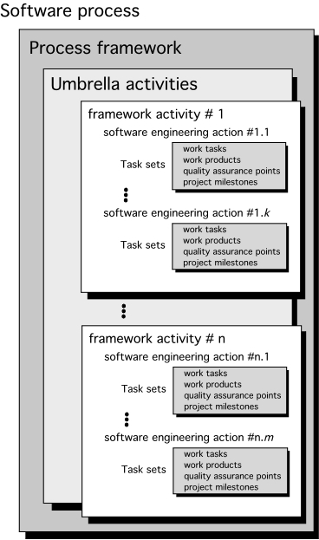
A Generic Process Model

Slide 7
A Generic Process Model
As we discussed before, a generic process framework for software engineering defines five framework activities- communication, planning, modeling, construction, and deployment.
In addition, a set of umbrella activities- project tracking and control, risk management, quality assurance, configuration management, technical reviews, and others are applied throughout the process.
Notes:
In the field of software engineering, risk management is a methodology or a mechanism, carried out throughout the development process to identify, manage and control risks evolved before and during the development process. Basically, three types of activities are covered under the risk management process.
Risks: Technology risk, People risk, Organization risk, Business risk, Market risk, Strategic risk, Sales risk. Management risk, Budget risk

Slide 8
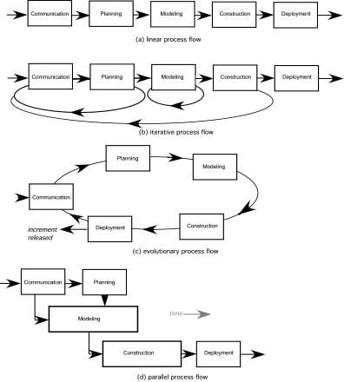
Process Flow

Slide 9
Process Flow
Linear process flow executes each of the five activities in sequence.
An iterative process flow repeats one or more of the activities before proceeding to the next.
An evolutionary process flow executes the activities in a circular manner. Each circuit leads to a more complete version of the software.
A parallel process flow executes one or more activities in parallel with other activities ( modeling for one aspect of the software in parallel with construction of another aspect of the software.

Slide 10
Linear
Simplicity
Iterative
Adaptability
Evolutionary
Efficiency
Parallel
Continuous improvement

Slide 11
Linear
Simplicity
Iterative
Adaptability
Evolutionary
Continuous improvement
Parallel
Efficiency
Waterfall Software Development for Regulatory Compliance
In industries with strict regulatory requirements, such as pharmaceuticals or aerospace, software projects often follow a linear Waterfall process flow. The project progresses through well-defined stages: requirements gathering, design, implementation, testing, and maintenance, with each stage building on the previous one. Changes are carefully controlled to ensure compliance with regulations and standards.

Slide 12
Linear
Simplicity
Iterative
Adaptability
Evolutionary
Continuous improvement
Parallel
Efficiency
Mobile App Development with Scrum
Mobile app development often follows an iterative process flow using Agile methodologies like Scrum. Teams work in short iterations (sprints), typically two to four weeks long. During each sprint, they develop, test, and refine features based on user feedback and evolving requirements. The project evolves through multiple iterations, allowing for flexibility and regular product releases.

Slide 13
Linear
Simplicity
Iterative
Adaptability
Evolutionary
Continuous improvement
Parallel
Efficiency
Social Media Platform Development
Social media platforms like Facebook or Twitter follow an evolutionary process flow. They release a basic version of the platform with essential features, gather user feedback, and continuously evolve by adding new features and improving existing ones based on user interactions and market trends.

Slide 14
Linear
Simplicity
Iterative
Adaptability
Evolutionary
Continuous improvement
Parallel
Efficiency
Video Game Development
Video game development often involves parallel process flows. Different teams work on various aspects simultaneously, such as game design, graphics, sound, and programming. For instance, artists create assets in parallel with developers coding the game engine. This parallelism speeds up the overall development process.

Slide 15
The Waterfall Model
It is the oldest paradigm for SE. When requirements are well defined and reasonably stable, it leads to a linear fashion.
The classic life cycle suggests a systematic, sequential approach to software development.

Slide 16
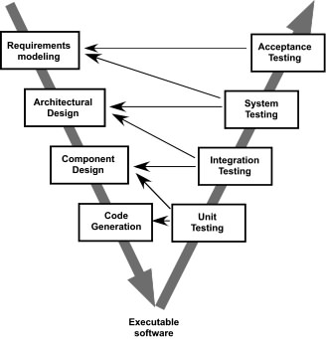
The V-Model
A variation of waterfall model depicts the relationship of quality assurance actions to the actions associated with communication, modeling and early code construction activates.
Team first moves down the left side of the V to refine the problem requirements. Once code is generated, the team moves up the right side of the V, performing a series of tests that validate each of the models created as the team moved down the left side.

Slide 17
The Incremental Model
It combines elements of linear and parallel process flows. Each linear sequence produces deliverable increments of the software.
The first increment is often a core product with many supplementary features. Users use it and evaluate it with more modifications to better meet the needs.

Slide 18
Evolutionary Models
Software system evolves over time as requirements often change as development proceeds. Thus, a straight line to a complete end product is not possible. However, a limited version must be delivered to meet competitive pressure.
Usually, a set of core product or system requirements is well understood, but the details and extension have yet to be defined.
You need a process model that has been explicitly designed to accommodate a product that evolved over time.
It is iterative that enables you to develop increasingly more complete version of the software.
Two types are introduced, namely Prototyping and Spiral models.

Slide 19
Evolutionary Models: Prototyping
Quick
plan
communication
Modeling
Quick design
Deployment
delivery &
feedback
Construction
of prototype

Slide 20
Evolutionary Models: The Spiral

Slide 21
Software Process Improvement

Slide 22
SPI
Software process improvement is a set of activities that will lead to a better software process and in result higher quality software delivered in a more timely manner.
The people who champion SPI come from three groups: technical managers, software engineers and individuals who have quality assurance responsibility.

Slide 23
Cont..
The approach to SPI is iterative and continuous, but it can be viewed in five QUICK LOOK steps:
Assessment of the current software process
Education and training of practitioners and managers
Selection and justification of process elements, software engineering methods, and tools
Implementation of the SPI plan,
Evaluation and tuning based on the results of the plan

Slide 24
Assessment and Gap Analysis in SPI
Assessment allows you to analyse the current working process, you find out the strengths and weaknesses of the current process in the assessment phase.
The difference between local application and best practice represents a “gap” that offers opportunities for improvement.

Slide 25
Education in SPI
When and SPI framework is introduced. It follows that a key element of any SPI strategy is education and training for practitioners, technical managers and more senior managers who have direct contact with the software organization. Three types of education and training should be conducted:
Generic concepts and methods. Directed toward both managers and practitioners, this category stresses both process and practice.

Slide 26
Cont..
Specific technology and tools. Directed primarily toward practitioners, this category stresses technologies and tools that have been adopted for local use. For example, if UML has been chosen for analysis and design modelling, a training curriculum for software engineering using UML would e established.
Business communication and quality related topics. Directed toward al stakeholders, this category focuses on soft topics that help enable better communication among stakeholders and foster a greater quality focus.

Slide 27
Selection and Justification in SPI
First, you should choose the process model that best fits organization, its stakeholders and the software that you build.
Secondly, if you choose something you should have a proper justification for choosing with authentic arguments.

Slide 28
Installation/ Migration in SPI
Installation is the 1st place where we see the impact of the SPI we have implemented.
Sometimes changes do not work the way we want, so we have to change the whole SPI.
Sometimes we don’t have any need to change the whole SPI but minor changes are required such changes are often referred to as process migration.

Slide 29
Evaluation in SPI
At this stage we evaluate the changes, this impact of the changes the quality in software product
All in all at this stage we evaluate all the changed we got after implementing the SPI to any process

Slide 30
Risk Management for SPI
There are three points at with risk management is important in SPI
Before staring the SPI
During SPI (Education, Installation and assessment)
At the time of evaluation
Risk can be of any type it can be of budget or schedule

Slide 31
Success factor of SPI
Critical Success Factors
Management Commitment and Support
Staff involvement
Process integration and understanding
A customized SPI strategy
Solid management of SPI project

Slide 32
Software Process Infrastructure

Slide 33
Software Process Infrastructure
an underlying base or foundation of an organization’s process environment to meet working conditions and ensure that there is a complete set of options available to perform every process effectively within the environment.
IT systems and software, physical hardware, human resources, tools and equipment, employee skills are some of the components of a typical process infrastructure.
Notes:
Such a foundation encompasses all services, capital equipment, resources and facilities that are required and essential for a company to successfully exist and operate.

Slide 34
Cont..
Software process infrastructure varies, depending on the size and complexity of the organization and the projects undertaken within the organization.
Notes:
Small, simple organizations and projects have small, simple infrastructure needs. Large, complex organizations and projects, by necessity, have larger and more complex software process infrastructures.

Slide 35
Control levels
A software process infrastructure may provide funding, tools, training, and staff members who have been assigned responsibilities for establishing and maintaining the software process infrastructure.
To oversee implementation and improvement of the software processes essentially, there are three control levels, such as:
Steering Committee
Management Team
Working groups

Slide 36
Steering Committee
Includes executives or high-level managers
Committee members oversee infrastructure elements, review progress of process improvement projects, develop strategic objectives, and make major decisions regarding development direction of existing processes.

Slide 37
Management Team
Consists of middle managers who provide supervision and control of existing processes.
Group members receive advice and guidance from senior managers of the steering committee.
The team takes care of process improvements, organizational changes, team collaboration, team communications, performance tracking, and configuration management.

Slide 38
Working Groups
are formed from various specialists who solve specific problems and develop solutions identified by the management team.
Each working group is an organized team that has a range of objectives and goals to be addressed to solve a process problem and develop a process improvement solution.

Slide 39
Misperception
Establishing a software process infrastructure and implementing repeatable software processes will add time and cost to software development and maintenance.
There is a cost associated with introducing or improving a software process.
Experience has shown that implementing systematic improvement of software processes tends to result in lower cost through improved efficiency, avoidance of rework, and more reliable and affordable software. Process performance thus influences software product quality.

